Slide 1
Communication Styles
Adapted from:Mark Murphy
Written in Forbes
http://www.forbes.com/sites/markmurphy/2015/08/06/which-of-these-4-communication-styles-are-you/

Slide 2
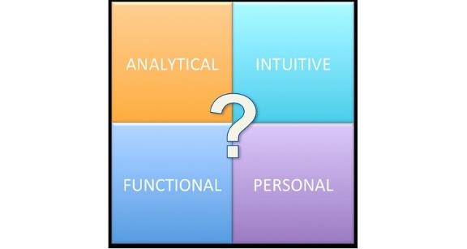
Different Communication styles and models
This is one model
People are a combination of styles but lean toward one more strongly

Slide 3
Analytical Communicator
You share and want information that uses data and real numbers
Question communication that doesn’t use these
Precise language
Feeling and emotional words aren’t used often
Look at issues logically and without emotion

Slide 4
Analytical Communicator
Challenges
May appear cold and unfeeling
Can tend to be impatient when conversation has feelings and emotion
Remember this communicator wants the facts in a precise way. Test scores improved is not enough detail – exactly how much.

Slide 5
Intuitive Communicator
Big picture – not too many details
Want to cut right to the point
Need a broad overview and it doesn’t need to be linear
Communication is quick and too the point

Slide 6
Intuitive Communicator
Challenges
Can become impatient if there are too many details
Would be most challenged by the Functional Communication style

Slide 7
Functional Communicator
Detail, well thought out plans and timelines
Communicate in a linear fashion going from a to b
Like process and detail – the devil is in the detail

Slide 8
Functional Communicator
Challenges
May lose people because there is too much detail
Intuitives are your biggest challenge

Slide 9
Personal Communicator
Emotional Language and connection
Want to discover what others think
Want to know how they feel
Good listener
Diplomat
Relationships are important

Slide 10
Personal Communicator
Challenges
Styles that don’t attend to feelings can be challenging

Slide 11
Styles are not good or bad
Most of us re a combination of styles – tend to lean toward one more than others
Knowing your style or combination of styles helps you to be a better communicator
Be aware of others styles also improves communication

